Slide 1
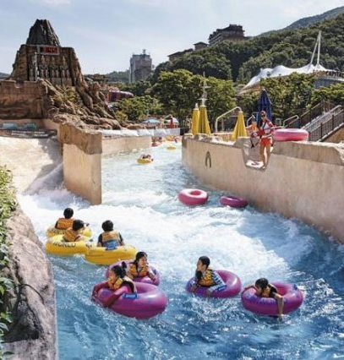
Water World
Writing programs that use functions and procedures

Slide 2
Do now task-
On Tuesday we looked at the 4 types of sub-programs.
Can you remember what they were?
Language for learning
Challenge-
Give reasons why commercial programs are broken down into subprograms?

Slide 3
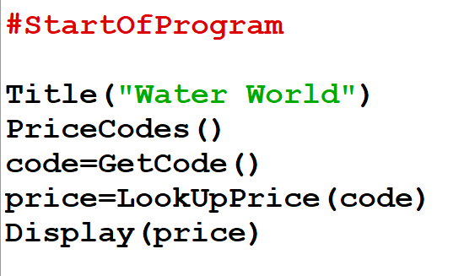
Here is the main program for waterworld.
Can you tell what kind of sub-program each line is calling?
(using Plicker)

Slide 4
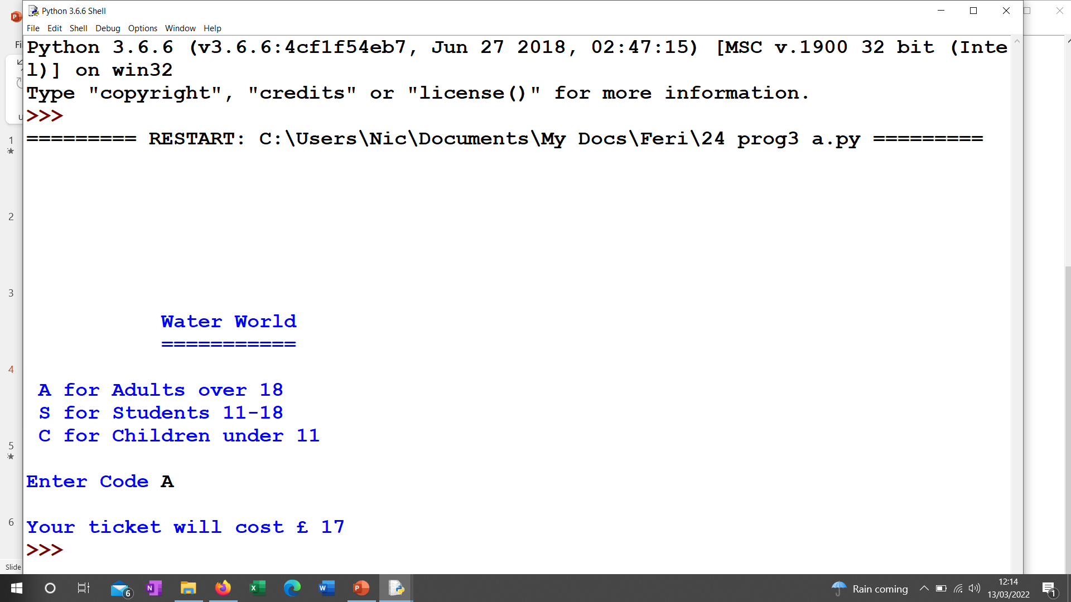
This is what the program should look like when the sub-programs are added correctly

Slide 5
We will start with the second line because it is the easiest
PriceCodes()
This procedure must
Display the 3 lines about the ticket codes
Add 1 blank line
Task 1
Write the procedure that goes with
PriceCodes()

Slide 6
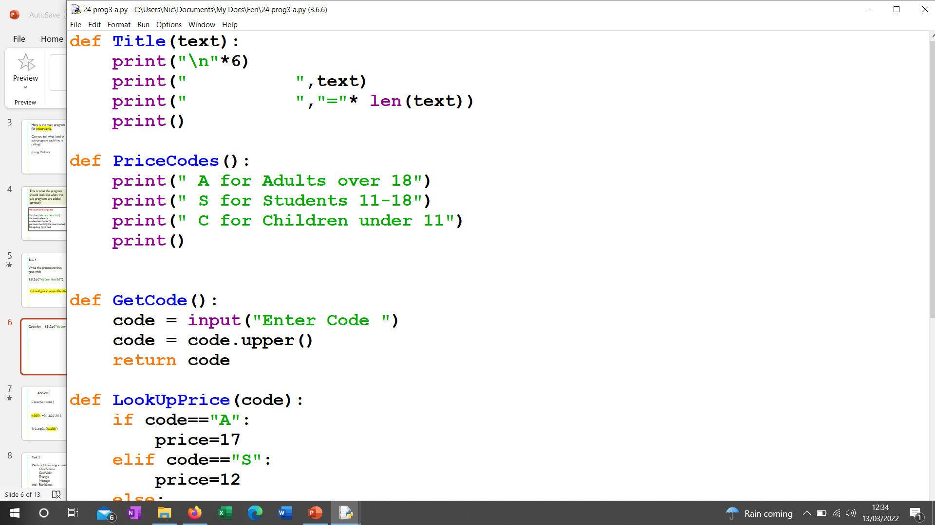
Answer: PriceCodes()

Slide 7
Title(“Water World”)
This procedure has a parameter which we will call text. It must
Draw 6 blank lines
Add 10 spaces, then text
Add 10 spaces and Underline text
Add 1 blank line
Task 2
Write the procedure that goes with
Title(“Water World”)

Slide 8
Answer: Title(“Water World”)

Slide 9
code=GetCode()
This is a function so it must end with a return. It must
Ask the user to enter a code
Turn the code into a capital letter
Return the code
Task 3
Write the procedure that goes with
code=GetCode()

Slide 10
Answer: code=GetCode()

Slide 11
price=LookUpPrice(code)
This is a function so it must end with a return and it uses a parameter called code.
If the code is A then the price is 17
If the code is S then the price is 12
Otherwise it must be a child so the price is 9
Return the price
Task 4
Write the procedure that goes with
price=LookUpPrice(code)

Slide 12
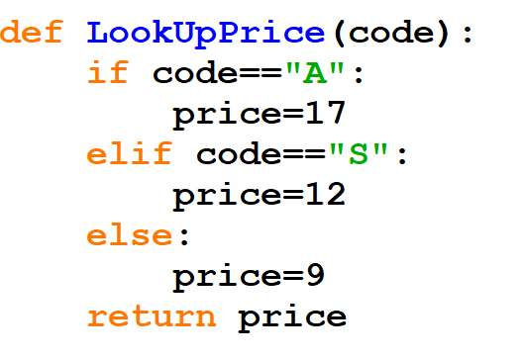
Answer: price=LookUpPrice(code)

Slide 13
And finally the last line is
Display(price)
This is a procedure with a parameter called price.
Add a blank line
Print out the final message including the price
You should be able to work this one out for yourself by now

Slide 14
Task 5
Load up waterworld
Using your notes, finish it off by adding the sub-programs at the start. Check its working.

Slide 15
At the moment your program only gives you the price of one ticket
v2. Can you add an extra function
people=GetPeople()
which asks for and returns the number of people in the group. If you add it after PriceCodes() and then set up a FOR LOOP around the rest of the main program it should ask for a code for everyone in the group.
v3. To then get the total price set up a variable called total in the main program and create another procedure which prints out the total price at the end

